Slide 1
CS 295A/395D: Artificial Intelligence
States and Actions, Transitions and Probabilities
Prof. Emma Tosch
14 February 2022

Slide 2
Recall…Planning
Logic and ontologies gave us the foundations for the rest of the semester.
Planning is the selection of actions to achieve a goal without interacting with an environment.
An action is an intervention in an environment that may change its state.
An intervention is a procedure for manipulating state.
The state of an environment is the current set of categories in our knowledge base…
(think: snapshot of the database that holds this information and the elements of the relations)
A goal is a function of a state.

Slide 3
Transitions
Agents take actions.
Actions may change state.
States may change without an agent taking an action (i.e., without intervention).
Need a more general term: transitions.

Slide 4
Example: course offerings
SOC changes every semester
A state is the current semester’s offerings
Transitions between semesters happens even if you (the individual) don’t take classes!
Other people taking classes == part of the environment/state
Focus: a single department’s offerings (e.g., CS)

Slide 5
Graphical representation of transitions
For now, we assume transition == action taken
RC1
RC3
RC1
RC2

Slide 6
Symbolic representations of transitions

Slide 7
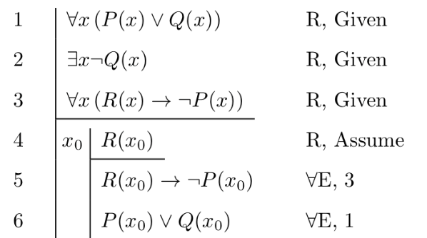
Examples of states
Proof state after inference i
Knowledge base at time t
Courses taken & offered at the end of semester s

Slide 8
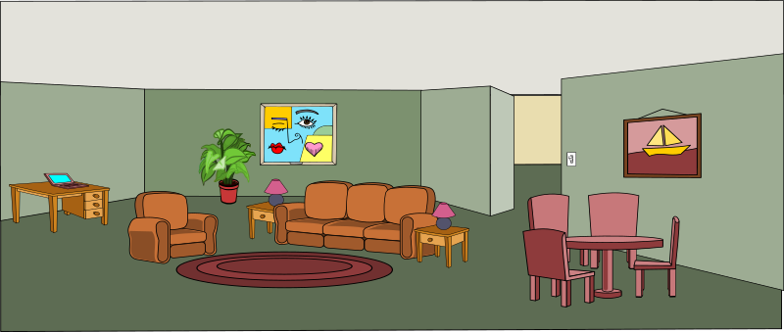
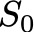


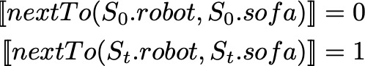
Examples of states
Proof state after inference i
Knowledge base at time t
Courses taken & offered at the end of semester s

Slide 9
Examples of states
Proof state after inference i
Knowledge base at time t
Courses taken & offered at the end of semester s

